Slide 1
Optimization on black-box function by parameter shift rule (PSR)

Slide 2
Outline
Problem
Backgrounds
Methods
Grid Search
My Method – Grid Bubble Search
Results

Slide 3
PROBLEM

Slide 4

Problem
Input: the function 𝑓 (𝑓 is a black box), $f′(x_{0})$
Output: $f′$ at all $x∈𝔻$

Slide 5

Problem-Example
Input
Output
x | f(x)
0 | 0
0.1 | 0.01
0.2 | 0.04
… | …
5 | 25
x | f’(x)
0 | ?
0.1 | ?
0.2 | ?
… | …
5 | ?
And $f’(3) =6$

Slide 6
BACKGROUNDS

Slide 7
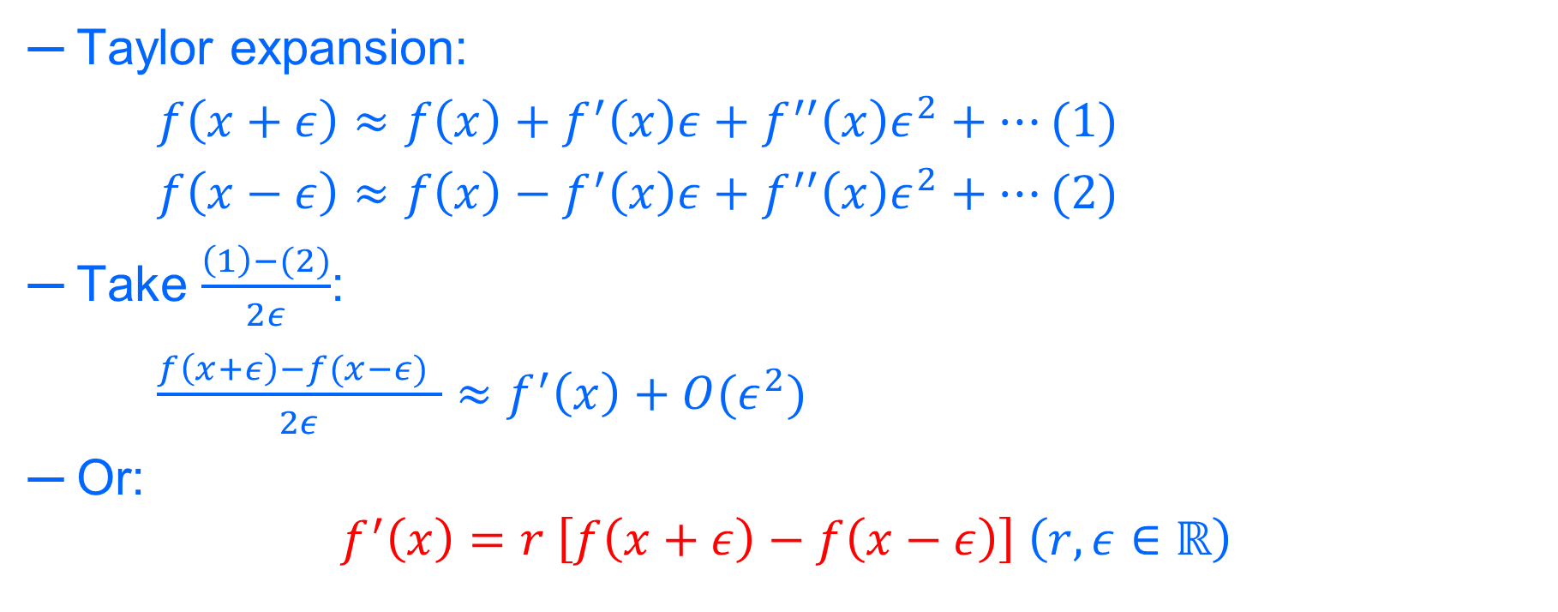
Numerical differentiation
Taylor expansion:
$f\left(x+ε\right)≈f\left(x\right)+f^{′}\left(x\right)ε+f^{′′}\left(x\right)ε^{2}+…(1)$
$f\left(x−ε\right)≈f\left(x\right)−f^{′}\left(x\right)ε+f^{′′}\left(x\right)ε^{2}+…(2)$
Take $\frac{\left(1\right)−(2)}{2ε}$:
$\frac{f\left(x+ε\right)−f(x−ε) }{2ε}≈f^{′}\left(x\right)+O(ε^{2})$
Or:
$$f^{′}\left(x\right)=r \left[f\left(x+ε\right)−f\left(x−ε\right)\right] \left(r,ε∈ℝ\right)$$

Slide 8

Numerical differentiation
Example 1: assume we want to calculate the value of $f′(3)$
$$f^{′}\left(3\right)=r \left[f\left(3+ε\right)−f\left(3−ε\right)\right]$$
$⇒$ Find the value of $r$ and $ε$ with $r,ε∈ℝ$

Slide 9

Numerical differentiation
Example 2: $f\left(x\right)=x^{2}$
$f^{′}(x)=r\left({\left(x+ε\right)}^{2}−{\left(x−ε\right)}^{2}\right)=r\left(x^{2}+2xε+ε^{2}−x^{2}+2xε−ε^{2}\right)$
$f′\left(x\right)=r\left(4xε\right)$
Thus:
$r\left(4xε\right)={\left(x^{2}\right)}^{′}=2x$
So that:
$⇒r=\frac{1}{2ε}$,$ε∈ℝ\backslash \{0\}$

Slide 10
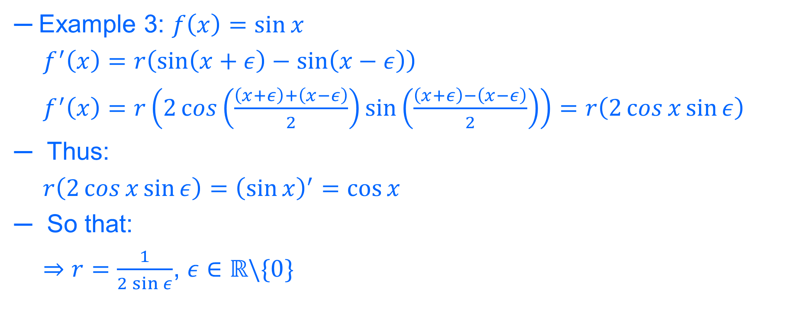
Numerical differentiation
Example 3: $f\left(x\right)=\sin{x}$
$f^{′}\left(x\right)=r\left(\sin\left(x+ε\right)−\sin\left(x−ε\right)\right)$
$f^{′}\left(x\right)=r\left(2\cos\left(\frac{\left(x+ε\right)+\left(x−ε\right)}{2}\right)\sin\left(\frac{\left(x+ε\right)−\left(x−ε\right)}{2}\right)\right)=r\left(2\cos{x}\sin{ε}\right)$
Thus:
$r\left(2\cos{x}\sin{ε}\right)={\left(\sin{x}\right)}^{′}=\cos{x}$
So that:
$⇒r=\frac{1}{2\sin{ε}}$, $ε∈ℝ\backslash \{0\}$

Slide 11
METHODS

Slide 12
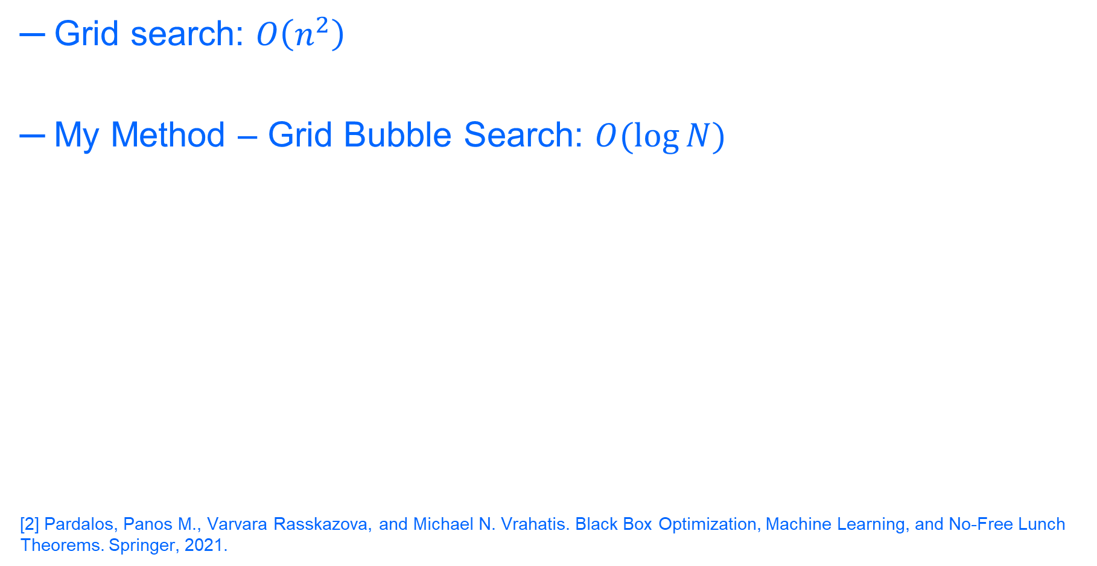
Methods
Grid search: $O\left(n^{2}\right)$
My Method – Grid Bubble Search: $O(\log{N})$
[2] Pardalos, Panos M., Varvara Rasskazova, and Michael N. Vrahatis. Black Box Optimization, Machine Learning, and No-Free Lunch Theorems. Springer, 2021.

Slide 13
GRID SEARCH

Slide 14


Grid search – Example
Input: $f(x)=sin⁡(x)$ (hidden)
Output
x | f(x)
0 | 0
0.1 | 0.10
0.2 | 0.19
… | …
5 | -0.95
x | f’(x)
0 | ?
0.1 | ?
0.2 | ?
…
5 | ?
And $f’(\frac{π}{3}) =0.5$ ($\cos{\frac{π}{3}}=0.5)$

Slide 15
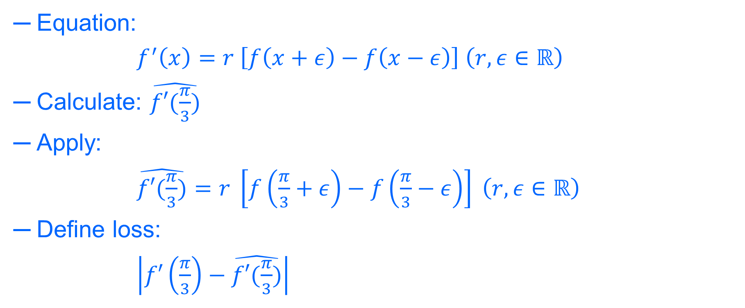
Grid search – Example
Equation:
$f^{′}\left(x\right)=r \left[f\left(x+ε\right)−f\left(x−ε\right)\right] \left(r,ε∈ℝ\right)$
Calculate: $\hat{f′(\frac{π}{3})}$
Apply:
$\hat{f′(\frac{π}{3})}=r \left[f\left(\frac{π}{3}+ε\right)−f\left(\frac{π}{3}−ε\right)\right] \left(r,ε∈ℝ\right)$
Define loss:
$\left|f′\left(\frac{π}{3}\right)−\hat{f′(\frac{π}{3})}\right|$

Slide 16


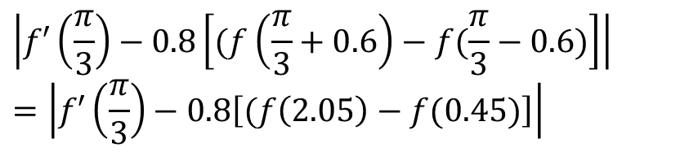
Grid search – Example
 | 0 | 0.2 | 0.4 | 0.6 | 0.8
0 | 0.50 | 0.50 | 0.50 | 0.50 | 0.50
0.2 | 0.50 | 0.46 | 0.42 | 0.38 | 0.34
0.4 | 0.50 | 0.42 | 0.34 | 0.27 | 0.19
0.6 | 0.50 | 0.39 | 0.27 | 0.16 | 0.05
0.8 | 0.50 | 0.36 | 0.21 | 0.07 | 0.07
$$r$$
$$ε$$
$$\left|f′\left(\frac{π}{3}\right)−0.8\left[(f\left(\frac{π}{3}+0.6\right)−f⁡(\frac{π}{3}−0.6)\right]\right|$$
$$=\left|f′\left(\frac{π}{3}\right)−0.8\left[(f\left(2.05\right)−f⁡(0.45)\right]\right|$$

Slide 17
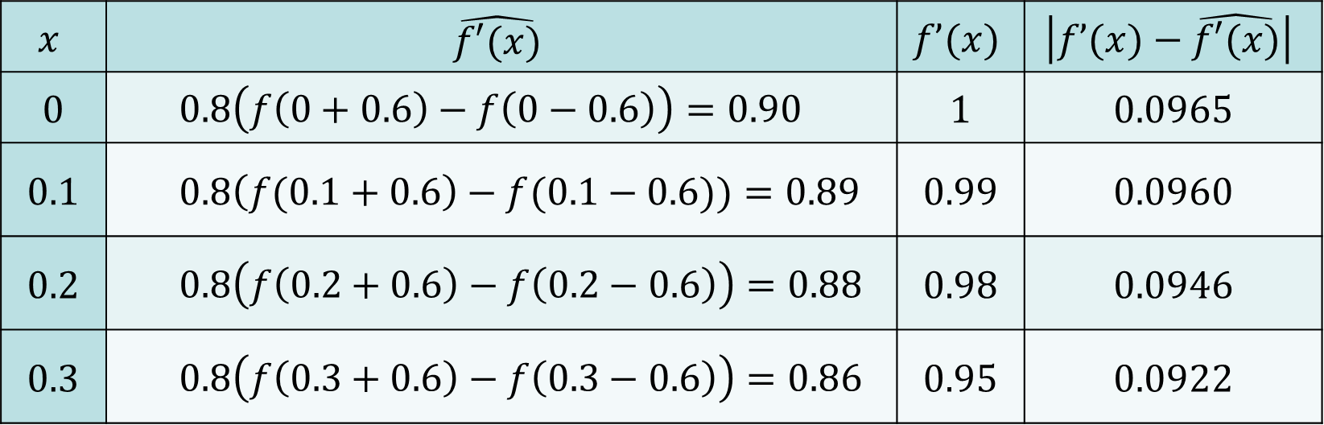
Grid search – Example
$$x$$ | $$\hat{f′(x)}$$ | $$f’(x)$$ | $$\left|f’(x)−\hat{f′(x)}\right|$$
0 | $$0.8\left(f\left(0+0.6\right)−f\left(0−0.6\right)\right)=0.90$$ | 1 | 0.0965
0.1 | $$0.8\left(f(0.1+0.6\right)−f(0.1−0.6))=0.89$$ | 0.99 | 0.0960
0.2 | $$0.8\left(f\left(0.2+0.6\right)−f\left(0.2−0.6\right)\right)=0.88$$ | 0.98 | 0.0946
0.3 | $$0.8\left(f\left(0.3+0.6\right)−f\left(0.3−0.6\right)\right)=0.86$$ | 0.95 | 0.0922
$\text{A}\text{verage} \text{Loss}=\frac{1}{N}\sum{\left|\frac{f’(x)−\hat{f′(x)}}{f′(x)}\right|}=\frac{1}{4}\left(\left|\frac{\text{0.0965} }{1}\right|+\left|\frac{\text{0.0960} }{0.99}\right|+\left|\frac{\text{0.0946 }}{0.98}\right|+\left|\frac{\text{0.0922 }}{0.95}\right|\right)$
$=0.096=9.6\%$

Slide 18
Grid-Bubble (GB) search

Slide 19
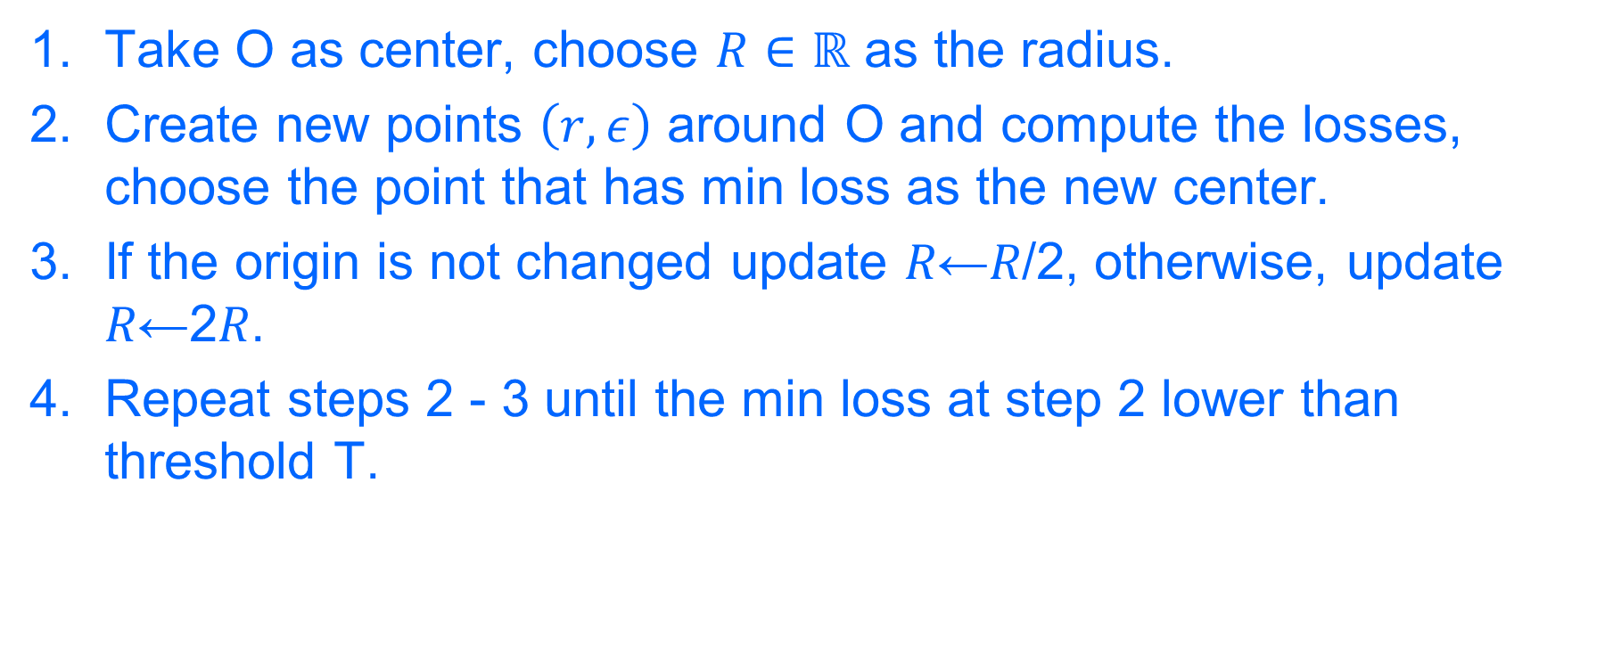
GB search
Take O as center, choose $R∈ℝ$ as the radius.
Create new points $\left(r,ε\right)$ around O and compute the losses, choose the point that has min loss as the new center.
If the origin is not changed update 𝑅←𝑅/2, otherwise, update 𝑅←2𝑅.
Repeat steps 2 - 3 until the min loss at step 2 lower than threshold T.

Slide 20
GB search – Example
Input: $f(x)=sin⁡(x)$ (hidden)
Output
x | f(x)
0 | 0
0.1 | 0.10
0.2 | 0.19
… | …
5 | -0.95
x | f’(x)
0 | ?
0.1 | ?
0.2 | ?
…
5 | ?
And $f’(\frac{π}{3}) =0.5$ ($\cos{\frac{π}{3}}=0.5)$

Slide 21

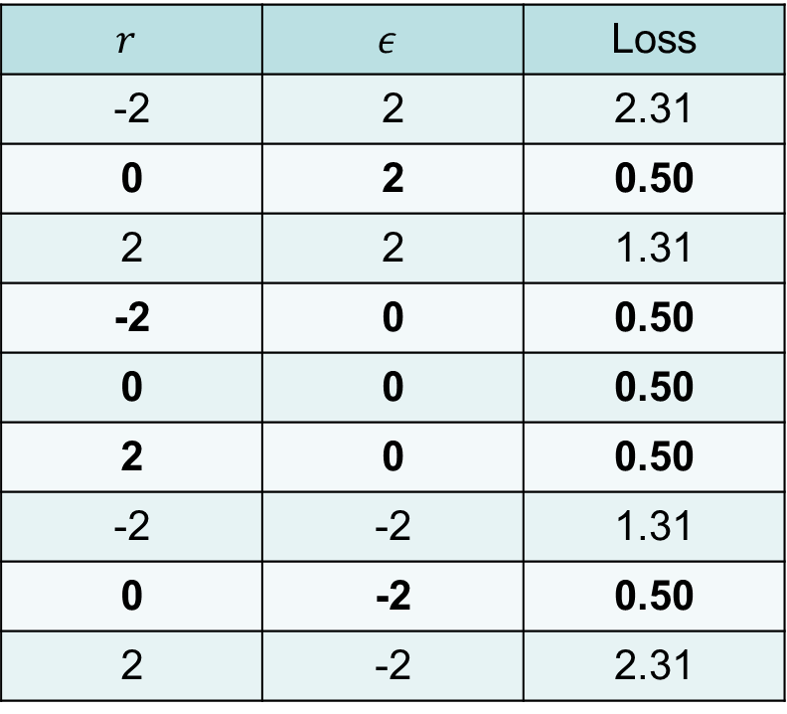

Iteration 1
$$r$$ | $$ε$$ | Loss
-2 | 2 | 2.31
0 | 2 | 0.50
2 | 2 | 1.31
-2 | 0 | 0.50
0 | 0 | 0.50
2 | 0 | 0.50
-2 | -2 | 1.31
0 | -2 | 0.50
2 | -2 | 2.31
$$ε$$
(2,2)
$$r$$
(0,0)
(-2,-2)

Slide 22



Iteration 1
$$ε$$
Step 3: The center (0,0) is not changed.
⇒ $R←\frac{R}{2}=\frac{2}{1}=1$
(2,2)
(1,1)
$$r$$
(0,0)
(-1,-1)
(-2,-2)

Slide 23

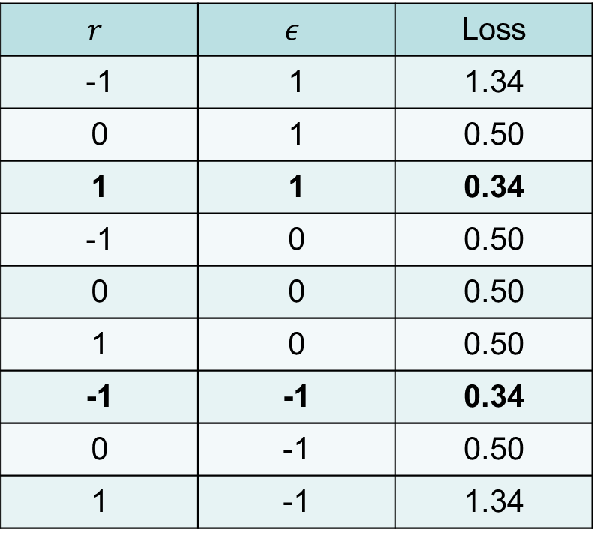

Iteration 2
$$r$$ | $$ε$$ | Loss
-1 | 1 | 1.34
0 | 1 | 0.50
1 | 1 | 0.34
-1 | 0 | 0.50
0 | 0 | 0.50
1 | 0 | 0.50
-1 | -1 | 0.34
0 | -1 | 0.50
1 | -1 | 1.34
$$ε$$
(1,1)
$$r$$
(0,0)
(-1,-1)

Slide 24



Iteration 2
$$ε$$
Step 3: The center is changed from $(0,0)$to $(1,1)$.
$⇒R←2R=2∗1=2$
(1,1)
$$r$$
(0,0)
(-1,-1)

Slide 25

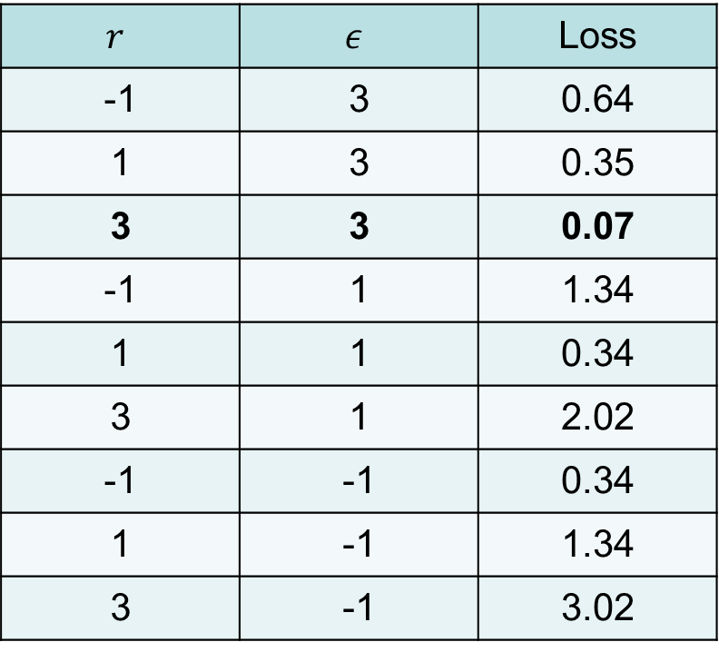

Iteration 3
$$ε$$
$$r$$ | $$ε$$ | Loss
-1 | 3 | 0.64
1 | 3 | 0.35
3 | 3 | 0.07
-1 | 1 | 1.34
1 | 1 | 0.34
3 | 1 | 2.02
-1 | -1 | 0.34
1 | -1 | 1.34
3 | -1 | 3.02
(3,3)
(1,1)
(3,1)
$$r$$
(0,0)
(-1,-1)

Slide 26
RESULTS

Slide 27
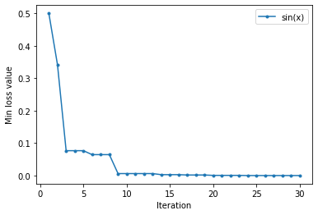
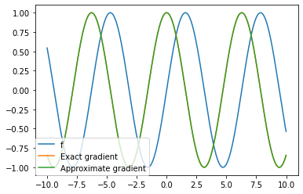
Results

Slide 28
References
[1] Schuld, Maria, et al. "Evaluating analytic gradients on quantum hardware." Physical Review A 99.3 (2019): 032331.
[2] Pardalos, Panos M., Varvara Rasskazova, and Michael N. Vrahatis. Black Box Optimization, Machine Learning, and No-Free Lunch Theorems. Springer, 2021.

Slide 29
Cảm ơn các bạn đã lắng nghe! ĐẠI HỌC QUỐC GIA TP.HCM TRƯỜNG ĐẠI HỌC CÔNG NGHỆ THÔNG TIN TP.HCM TOÀN DIỆN – SÁNG TẠO – PHỤNG SỰ

Slide 30



$\left|f′\left(\frac{π}{3}\right)−0.8\left[(f\left(\frac{π}{3}+0.2\right)−f⁡(\frac{π}{3}−0.2)\right]\right|$ $=\left|\cos\left(\frac{π}{3}\right)−0.8\left[(\sin\left(\frac{π}{3}+0.2\right)−sin⁡(\frac{π}{3}−0.2)\right]\right|$
 | 0 | 0.2 | 0.4 | 0.6 | 0.8
0 | 0.50 | 0.50 | 0.50 | 0.50 | 0.50
0.2 | 0.50 | 0.46 | 0.42 | 0.38 | 0.34
0.4 | 0.50 | 0.42 | 0.34 | 0.27 | 0.19
0.6 | 0.50 | 0.39 | 0.27 | 0.16 | 0.05
0.8 | 0.50 | 0.36 | 0.21 | 0.07 | 0.07
$$r$$
$$ε$$
Loss $= \left|f′\left(\frac{π}{3}\right)−\hat{f′(\frac{π}{3})}\right|=\left|f′\left(\frac{π}{3}\right)−r\left[(f\left(\frac{π}{3}+ε\right)−f⁡(\frac{π}{3}−ε)\right]\right|$

Slide 31

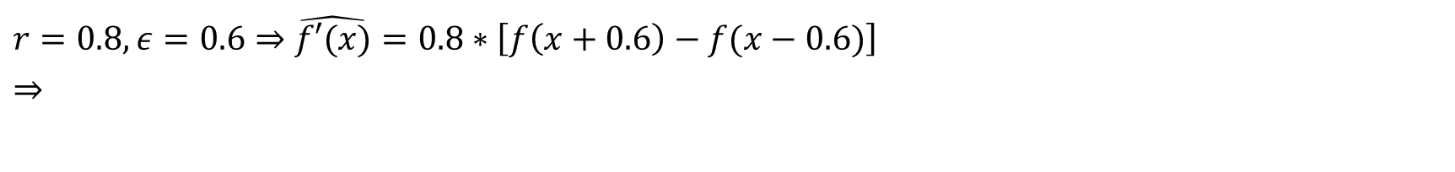
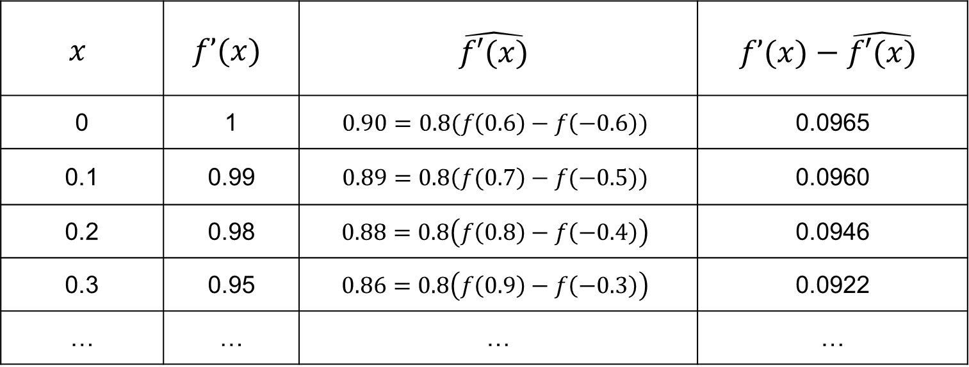
$r=0.8,ε=0.6⇒$ $\hat{f′(x)}=0.8∗\left[f\left(x+0.6\right)−f(x−0.6)\right]$
$⇒$
$$x$$ | $$f’(x)$$ | $$\hat{f′(x)}$$ | $$f’(x)−\hat{f′(x)}$$
0 | 1 | $$0.90=0.8(f\left(0.6\right)−f\left(−0.6\right))$$ | 0.0965
0.1 | 0.99 | $$0.89=0.8\left(f(0.7\right)−f(−0.5))$$ | 0.0960
0.2 | 0.98 | $$0.88=0.8\left(f\left(0.8\right)−f\left(−0.4\right)\right)$$ | 0.0946
0.3 | 0.95 | $$0.86=0.8\left(f\left(0.9\right)−f\left(−0.3\right)\right)$$ | 0.0922
… | … | … | …
$$\text{A}\text{verage} \text{Loss} =\frac{1}{N}\sum{\left|\frac{f’(x)−\hat{f′(x)}}{f′(x)}\right|}=\frac{1}{4}\left(\left|\frac{\text{0.0965} }{1}\right|+\left|\frac{\text{0.0960} }{0.99}\right|+\left|\frac{\text{0.0946} }{0.98}\right|+\left|\frac{\text{0.0922} }{0.95}\right|\right)=0.096=9.6\%$$

Slide 32



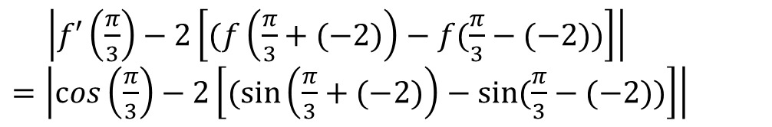
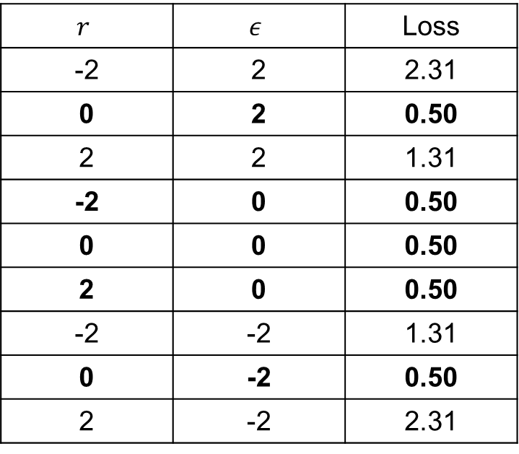
$$ε$$
Iteration 1
Step 1 & 2: center (0, 0), $R=2$
$$r$$ | $$ε$$ | Loss
-2 | 2 | 2.31
0 | 2 | 0.50
2 | 2 | 1.31
-2 | 0 | 0.50
0 | 0 | 0.50
2 | 0 | 0.50
-2 | -2 | 1.31
0 | -2 | 0.50
2 | -2 | 2.31
(2,2)
$$r$$
(0,0)
(-2,-2)
$\left|f′\left(\frac{π}{3}\right)−2\left[(f\left(\frac{π}{3}+(−2)\right)−f⁡(\frac{π}{3}−(−2))\right]\right|$
$=\left|\cos\left(\frac{π}{3}\right)−2\left[(\sin\left(\frac{π}{3}+(−2)\right)−sin⁡(\frac{π}{3}−(−2))\right]\right|$
Loss $= \left|f′\left(\frac{π}{3}\right)−r\left[(f\left(\frac{π}{3}+ε\right)−f⁡(\frac{π}{3}−ε)\right]\right|$

Slide 33



Iteration 1
Step 3: The center (0,0) is not changed $⇒R←\frac{R}{2}=\frac{2}{1}=1$
$$ε$$
(2,2)
(1,1)
$$r$$
(0,0)
(-1,-1)
(-2,-2)

Slide 34
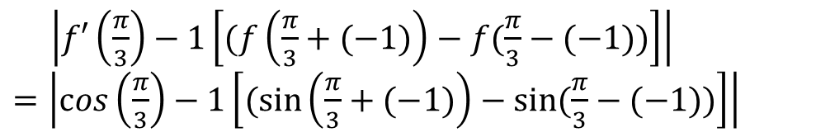
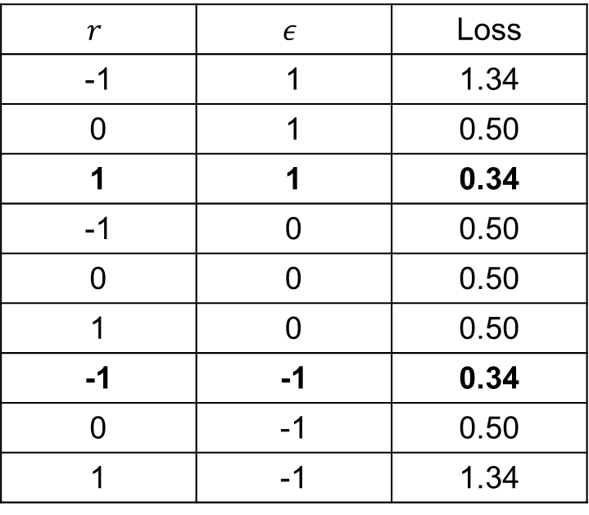
$$ε$$
Iteration 2
Step 1 & 2: center (0, 0), $R=1$
$$r$$ | $$ε$$ | Loss
-1 | 1 | 1.34
0 | 1 | 0.50
1 | 1 | 0.34
-1 | 0 | 0.50
0 | 0 | 0.50
1 | 0 | 0.50
-1 | -1 | 0.34
0 | -1 | 0.50
1 | -1 | 1.34
(1,1)
$$r$$
(0,0)
(-1,-1)
$\left|f′\left(\frac{π}{3}\right)−1\left[(f\left(\frac{π}{3}+(−1)\right)−f⁡(\frac{π}{3}−(−1))\right]\right|$
$=\left|\cos\left(\frac{π}{3}\right)−1\left[(\sin\left(\frac{π}{3}+(−1)\right)−sin⁡(\frac{π}{3}−(−1))\right]\right|$
Loss $= \left|f′\left(\frac{π}{3}\right)−r\left[(f\left(\frac{π}{3}+ε\right)−f⁡(\frac{π}{3}−ε)\right]\right|$

Slide 35



Iteration 2
Step 3: The center is changed from (0,0) to (1,1) $⇒R←2R=2∗1=2$
$$ε$$
(1,1)
$$r$$
(0,0)
(-1,-1)

Slide 36


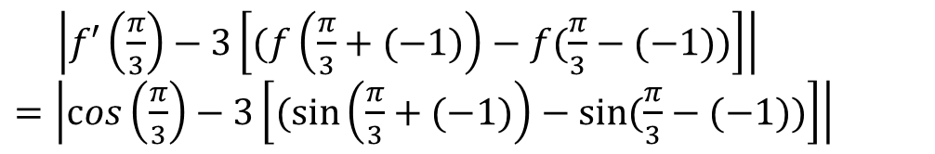
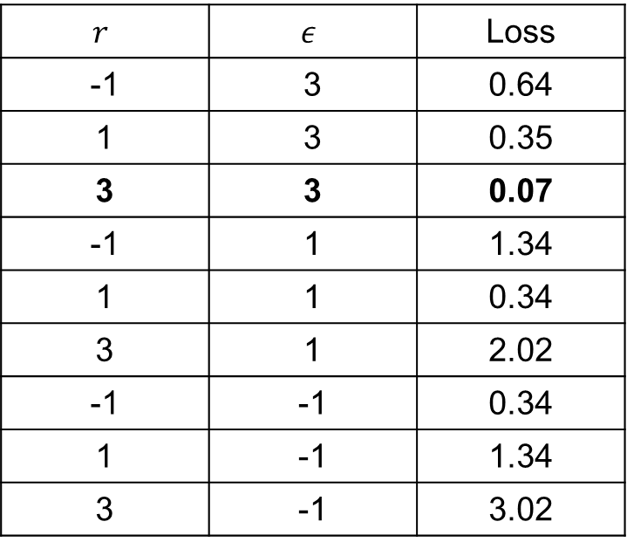
$$ε$$
(3,3)
Iteration 3
Step 1 & 2: center (1, 1), $R=2$
$$r$$ | $$ε$$ | Loss
-1 | 3 | 0.64
1 | 3 | 0.35
3 | 3 | 0.07
-1 | 1 | 1.34
1 | 1 | 0.34
3 | 1 | 2.02
-1 | -1 | 0.34
1 | -1 | 1.34
3 | -1 | 3.02
(1,1)
(3,1)
$$r$$
(0,0)
(-1,-1)
$\left|f′\left(\frac{π}{3}\right)−3\left[(f\left(\frac{π}{3}+(−1)\right)−f⁡(\frac{π}{3}−(−1))\right]\right|$
$=\left|\cos\left(\frac{π}{3}\right)−3\left[(\sin\left(\frac{π}{3}+(−1)\right)−sin⁡(\frac{π}{3}−(−1))\right]\right|$
Loss $= \left|f′\left(\frac{π}{3}\right)−r\left[(f\left(\frac{π}{3}+ε\right)−f⁡(\frac{π}{3}−ε)\right]\right|$

Slide 37
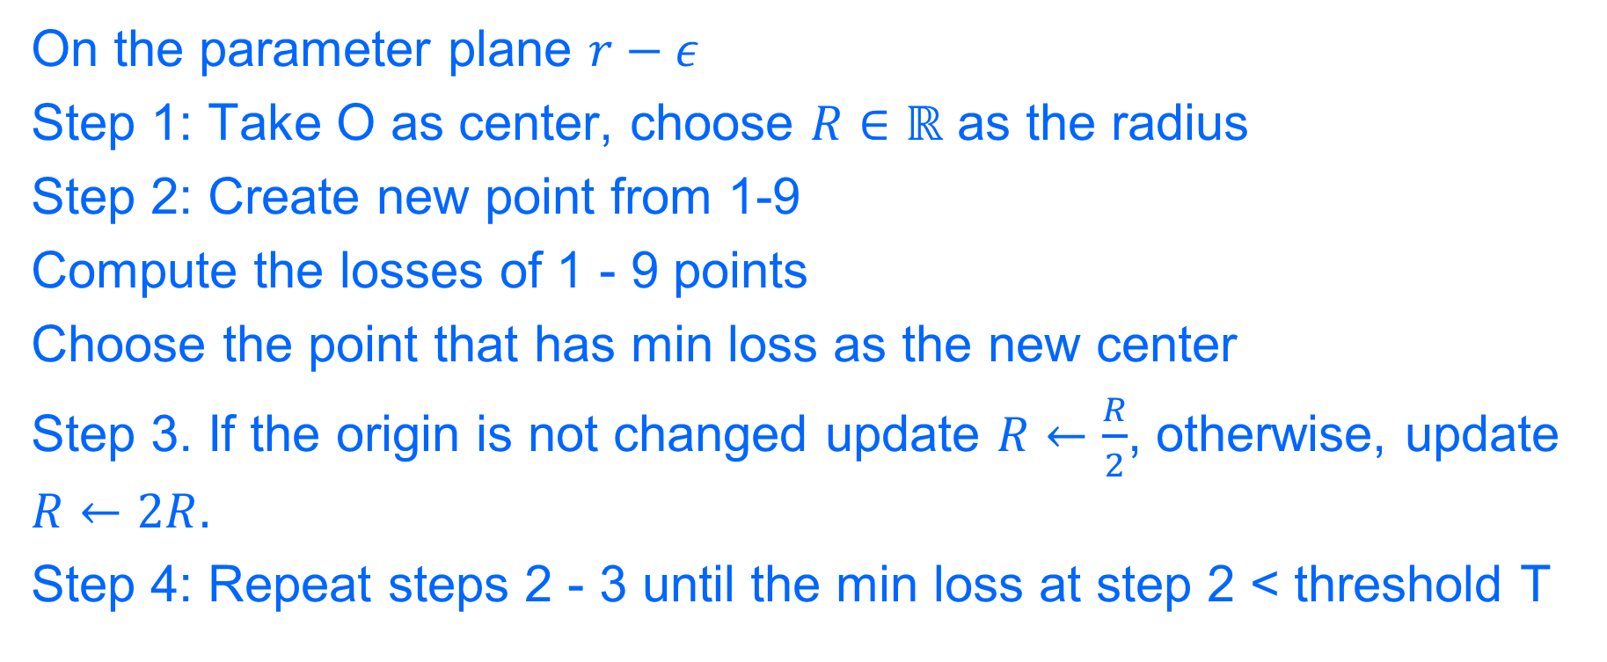
GB search
On the parameter plane $r−ε$
Step 1: Take O as center, choose $R∈ℝ$ as the radius
Step 2: Create new point from 1-9
Compute the losses of 1 - 9 points
Choose the point that has min loss as the new center
Step 3. If the origin is not changed update $R←\frac{R}{2}$, otherwise, update $R←2R.$
Step 4: Repeat steps 2 - 3 until the min loss at step 2 < threshold T

